Slide 1


VAISH COLLEGE OF ENGINEERING ROHTAK
TEAM TITANS
2025

Slide 2
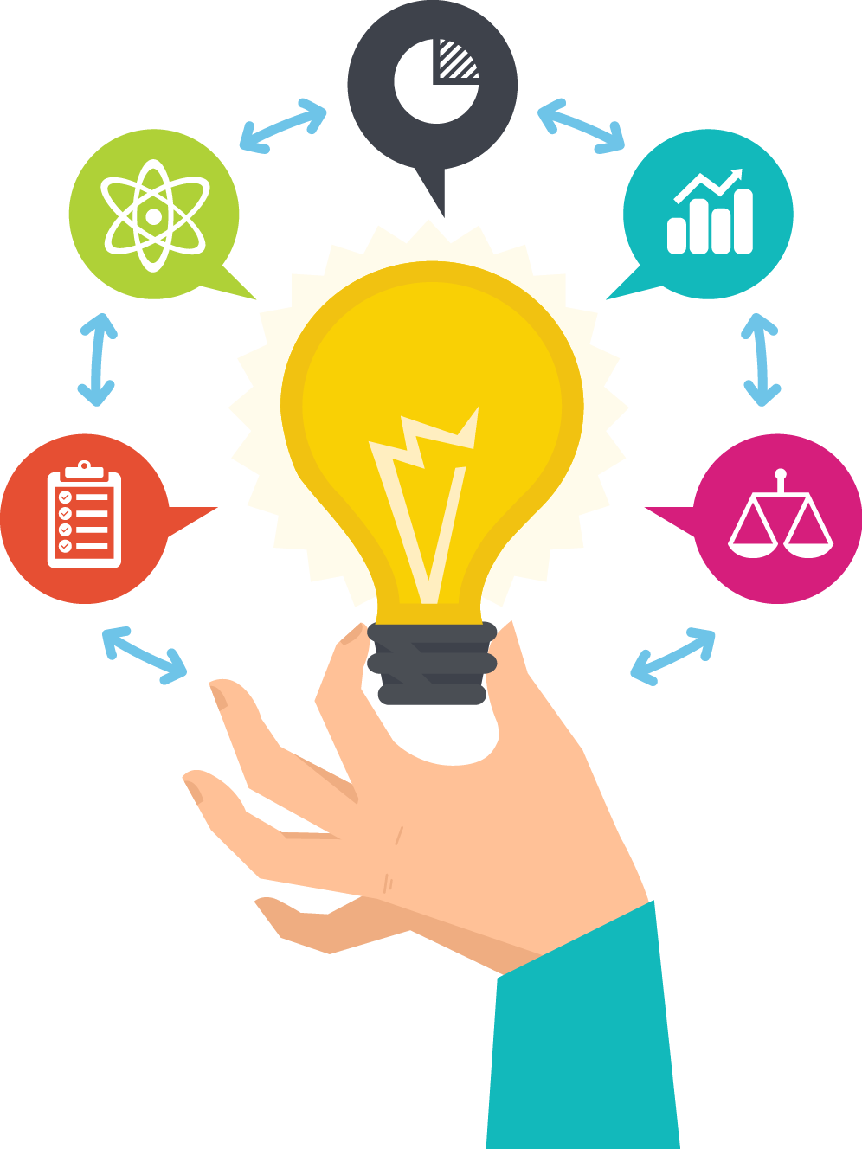
BUSINESS PROPOSAL PRESENTATION
"It's not about ideas it's about making ideas happen"

Slide 3
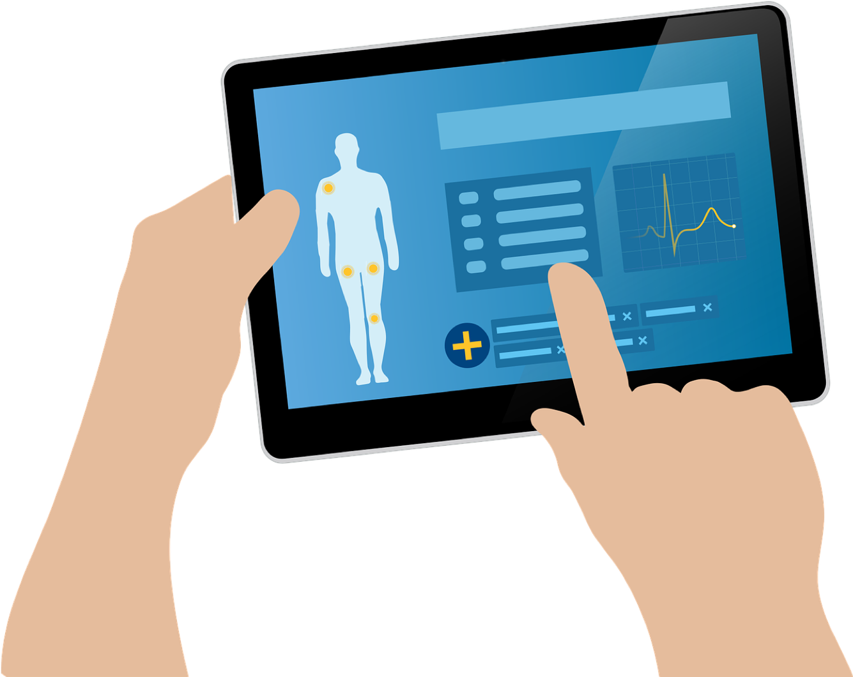
IoT
IoT is a network of physical objects embedded with sensors, software, and other technologies to connect and exchange data with other devices and systems over internet.
APPLICATIONS
SMART HEALTH CARE
SMART CITIES
SMALL RETAIL
SMART VECHICLES
SMART ENERGY

Slide 4
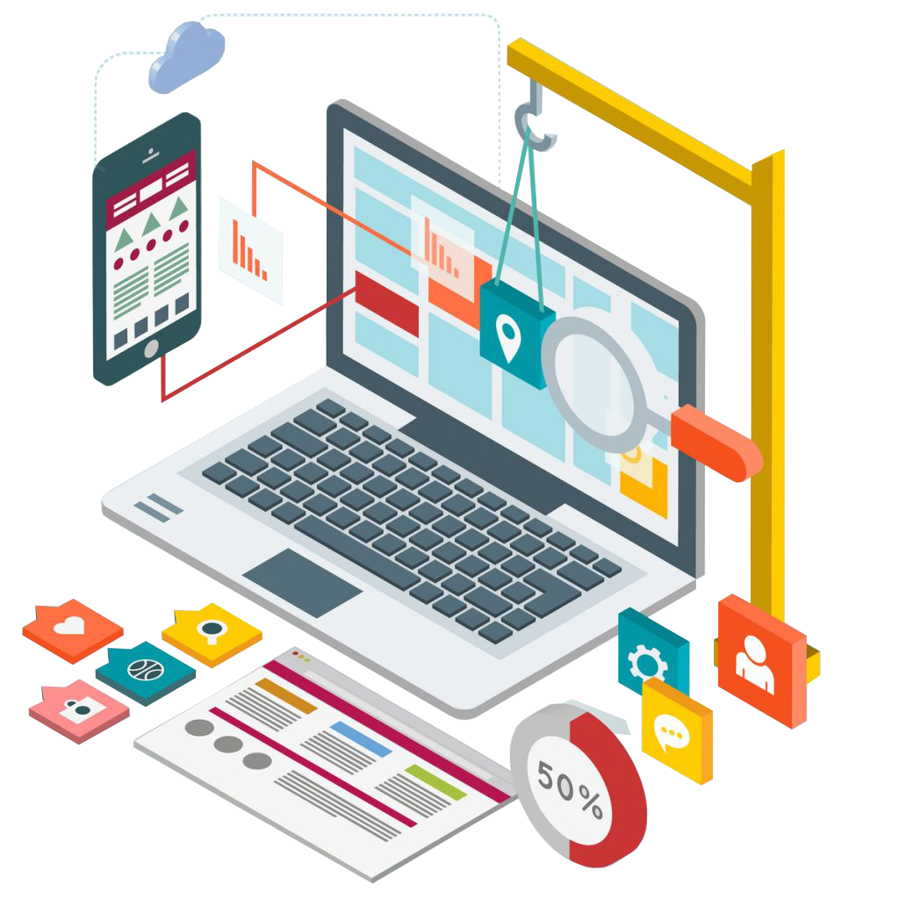
TECH FUSSION
Web Development involves creating and maintaining websites, ranging from simple static pages to complex web applications, using various technologies and encompassing front-end, back-end, and full-stack development roles.
APPLICATIONS
STATIC WEBSITES
DYNAMIC WEBSITES
WEB APPLICATIONS
E-COMMERCE WEB

Slide 5

MeCare
“Saving life, enhancing care, and shaping a healthier future”
Through this project we aims give a good health to every individual, by making health care accessible to them.
People can easily monitor their health parameters through the device and can directly connect to doctors
This will make people aware about their parameters and can prevent them from serious illness, even help them to continue their treatment and saving time at the time of emergency.

Slide 6

TEAM TITANS
NANCY (TEAM LEADER, PRSESENTER, PPT, COORDINATOR)
AYUSH SINGH (WEB SITE)
KUSHAL JHANGRA (WEBSITE)
LUCKY TANWAR (WEBSITE)
AAKANKSHA (PRESENTER, PPT , COORDINATOR)

Slide 7
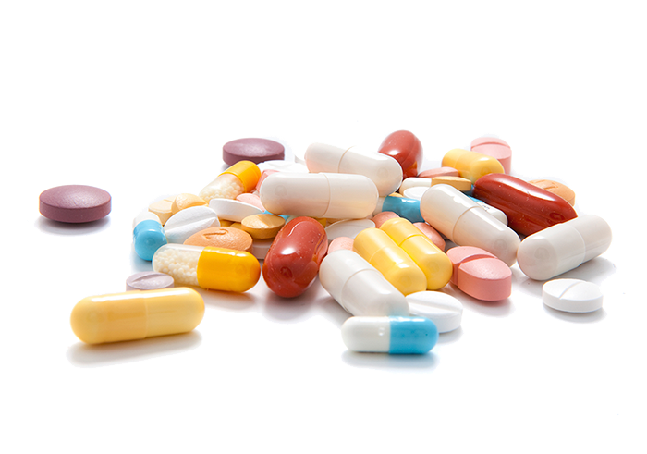
ISSUES IN HEALTHCARE
In the populated countries like India there are various healthcare issues:
Lack of Hospitals in isolated areas
Lack of Health awareness
Life style diseases are growing rapidly
Ignorance towards regular health check ups
Scarcity of resources at time of emergency
Lack of expert guidance
Ignorance to health due to busy routine

Slide 8
RESULTS
India has highest number of people with diabetes.
Obesity rates are high in India.
Rapid increase in cases of heart attacks.
Breast cancer and cervical cancer are detected late in women due to lack of awareness.
Delay in diagnosis of cancer
Increase in rates death rate due to delay in treatment.
Low life expectancy
Crowd in hospitals due to lack of doctors
High cost of treatment
Lack of productivity

Slide 9

MECARE “AB HEALTH GHAR PAR”
With the help of emerging new technology and innovation we have designed the website which provide information about your health parameters.
Can directly contact your doctor from any part of India
In case of emergency, you can update all your conditions to start timely treatment.
We can include all the government , private hospitals
It is time and life saviour
"BECAUSE WE CARE"

Slide 10

WHY TO CHOOSE US?
Monitoring your health parameters
Sending your regular reports to doctors from anywhere
Regular advice from experts.
Getting pre diagnosis of your disease and start timely treatment
Get treatment at you own place
Meeting with doctors no matter how far you are from them
Affordable way of staying Healthy

Slide 11

PERKS OF MeCare
We offer monthly and yearly subscription on our website
At just timely notifications of medicines and weekly summery graphs
In case of Emergency all the parameters are saved to start timely treatment
Virtual interaction with experts
Easy to use and monitor

Slide 12

MARKET POTENTIAL
The E-pharmacy market is expected to grow at CAGR of 16-18% in the next five years.
The global telemedicine market is expected to reach $460 billion by 2030, growing at CAGR of 20%+.
AI in healthcare is projected to reach $200 billion by 2030, improving diagnostics and automation.

Slide 13

Growth Opportunities
Partnership with Healthcare providers i.e., Collaborating with Hospitals, Clinics and Insurance companies.
Integration with wearable devices and IoT can enhance user engagement and provide more comprehensive health data.
5G and Edge computing in Healthcare analyze medical data in real-time , enabling remote healthcare services, such as telemedicine and remote monitoring.

Slide 14

FEASIBILITY
ACCESSIBLITY: Reach in remote and rural areas.
CONVENIENCE: Patients can consult doctors from home.
AWARENESS: Promoting health culture ( weekly reports, regular check ups, timely medication)
COST EFFECTIVE: Just monthly or yearly subscription ➕ appointment fee is more affordable than in ➖ person visits.
REAL TIME TRACKING: IoT devices help create customized health planes based on real time health tracking

Slide 15

CONCLUSION
Looking from the future perspective there will be emerging growth of Health care sector .
In the country like INDIA having remote locations where still health care is not efficient and even many people lost their live because of delay in treatments and late detection of disease, Users are in need get good treatment at their place
It will attract people of every age group because health is a vital need for human being .
People with chronic diseases including diabetes need to measure body parameter on regular basis.

Slide 16
CONCLUSION
“MeCare” believes that with the help of IoT devices and connectivity with communication devices we can make change in people's life

